Slide 1
20250319 LP-N1 PTC OOS event 8D report

Slide 2
Discipline 1. 選定團隊 Form the Team
團隊負責人Team Leader/Dept.:
成員Team Member/Dept.:
Name | Department | Position
 | S210
 | S220

Slide 3
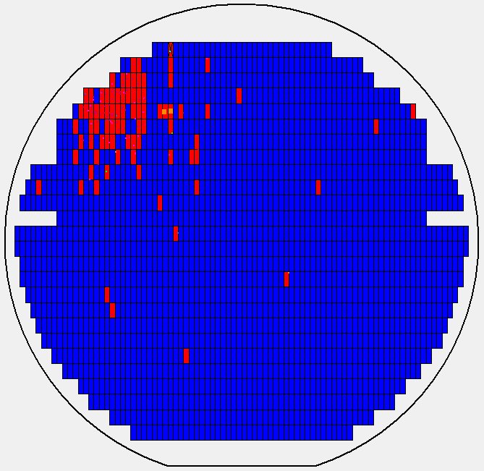
Discipline 2.描述問題及現況掌握Describe the Problem
(WHO detected the problem? WHAT is wrong? State the problem in terms of object and defect. WHERE the problem was first detected, describe location of the detection, lot #, WHEN and HOW it was detected)
What | S730 highlighted LP-N1 defect maps on 3/15.2025 Route: M030TIK Product: BA5D26 Lot number: 25092960 Oper: 4217 Qty: 25pcs
Where | 4217 station (SiN depo.)
When | 3/12~3/15
Extent | LP-N1 3/11~3/12 BPM 3/12~3/15 13 batches (78 lots; 1912 pcs of wafers) Scanned AOI defect impact lot Impact 7 lots (scanned 9 lots) AOI def. rate 0.03%~4.58% (1 pcs 4.58%/178ea., 1 pcs 3.8%/145ea., other <3%) No specific zones: C1, C2, C3, C4, C5 impacted Will re-work M030TI-BA5D26-25092960 and trace CP maps of whole impact lots LP-N1 was stopped on 3/15 and EQ was checking.

Slide 4
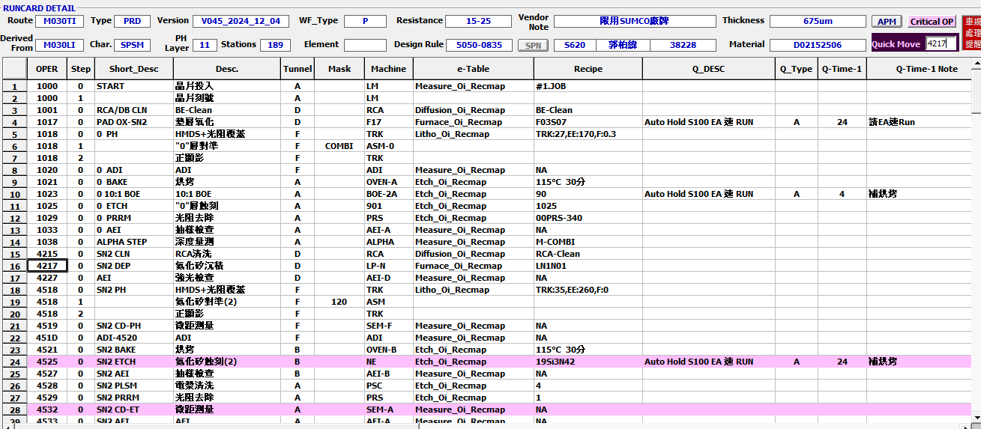
E-runcards
Discipline 2.描述問題及現況掌握Describe the Problem
(WHO detected the problem? WHAT is wrong? State the problem in terms of object and defect. WHERE the problem was first detected, describe location of the detection, lot #, WHEN and HOW it was detected)
<4217> SiN depo.

Slide 5
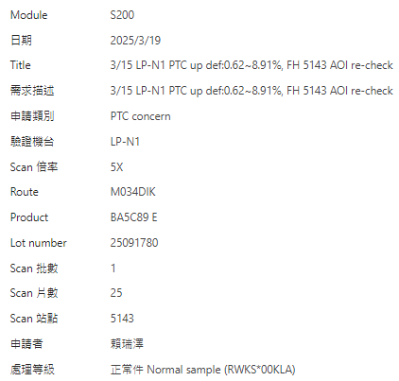
Discipline 2.描述問題及現況掌握Describe the Problem
(WHO detected the problem? WHAT is wrong? State the problem in terms of object and defect. WHERE the problem was first detected, describe location of the detection, lot #, WHEN and HOW it was detected)
S200 MS - 3/15 LP-N1 PTC up def:0.62~8.91%, FH 5143 AOI re-check

Slide 6
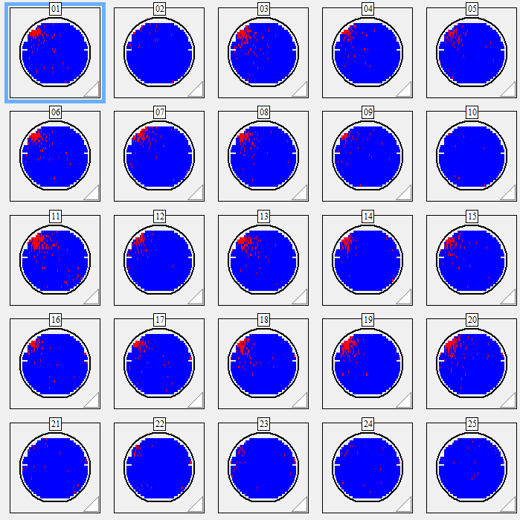
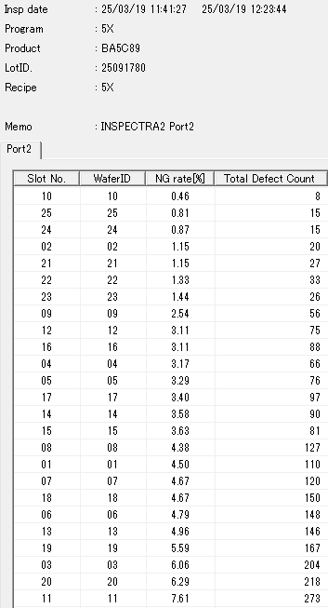
Discipline 2.描述問題及現況掌握Describe the Problem
(WHO detected the problem? WHAT is wrong? State the problem in terms of object and defect. WHERE the problem was first detected, describe location of the detection, lot #, WHEN and HOW it was detected)
S200 MS - 3/15 LP-N1 PTC up def:0.62~8.91%, FH 5143 AOI re-check
M034DIK-BA5C89-25091780-5025_op-5X Def% : 0.46~7.61%
Leica OM check #11 Local by LP-N1 PTC issue
Product to S210 confirm

Slide 7
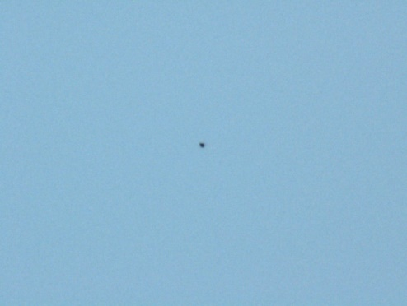
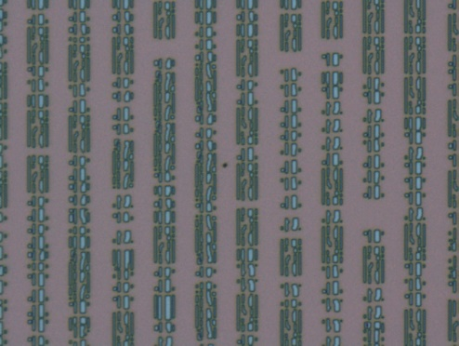

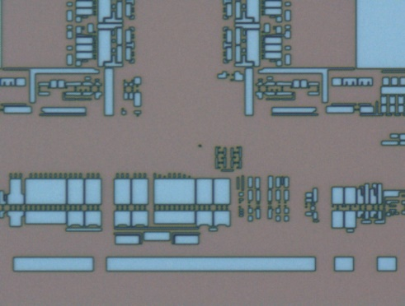
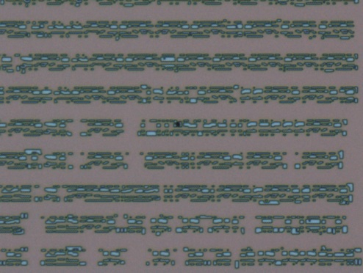
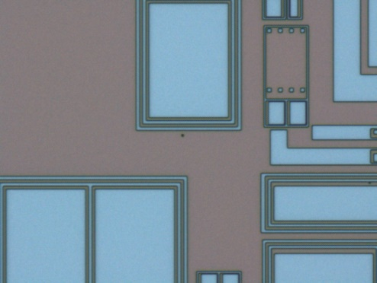
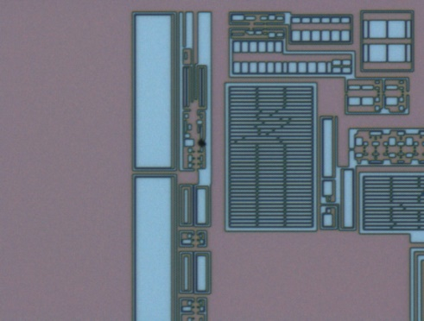
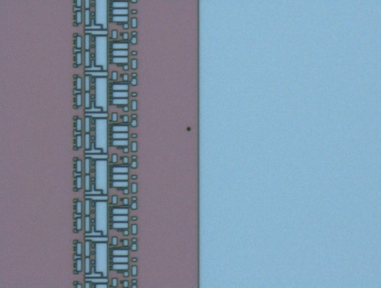
Discipline 2.描述問題及現況掌握Describe the Problem
(WHO detected the problem? WHAT is wrong? State the problem in terms of object and defect. WHERE the problem was first detected, describe location of the detection, lot #, WHEN and HOW it was detected)
#11
Leica OM check : #11 Local by LP-N1 PTC issue

Slide 8
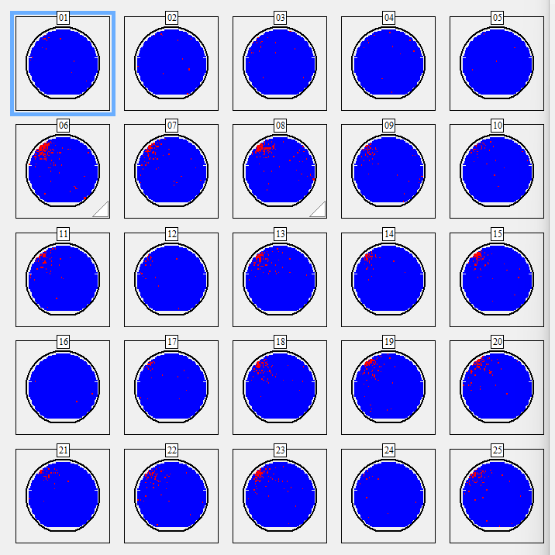
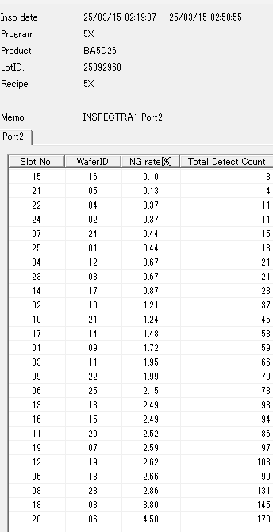
AOI - M030TI-BA5D26-25092960-4518
Discipline 2.描述問題及現況掌握Describe the Problem
(WHO detected the problem? WHAT is wrong? State the problem in terms of object and defect. WHERE the problem was first detected, describe location of the detection, lot #, WHEN and HOW it was detected)
M030TI-BA5D26-25092960-4518-op (No spec) – issue lot
Def 0.1~4.58%
21 pcs local map at 11 o’clock

Slide 9
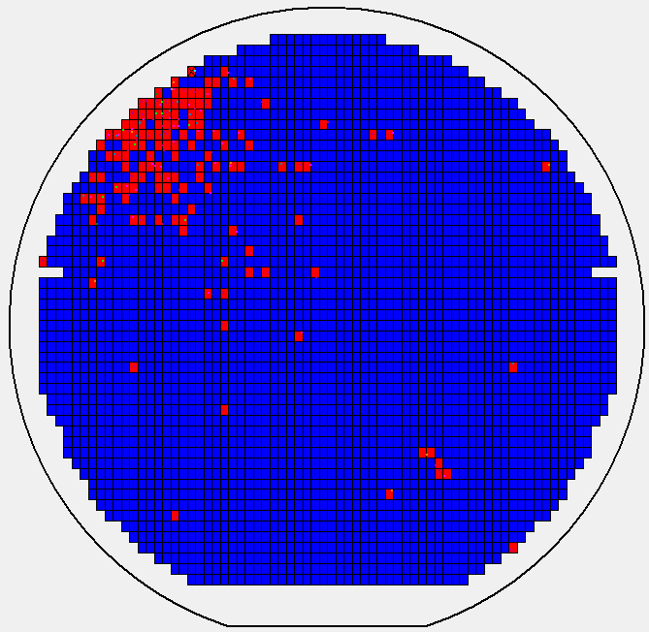
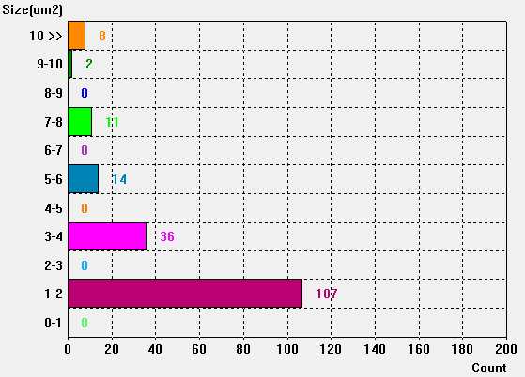
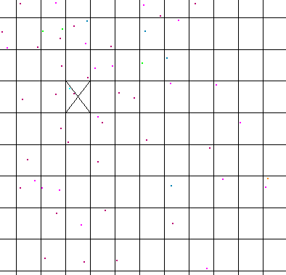
Discipline 2.描述問題及現況掌握Describe the Problem
(WHO detected the problem? WHAT is wrong? State the problem in terms of object and defect. WHERE the problem was first detected, describe location of the detection, lot #, WHEN and HOW it was detected)
#6
AOI map #6 by 11 o’clock
Defect size major: 1~2 um

Slide 10
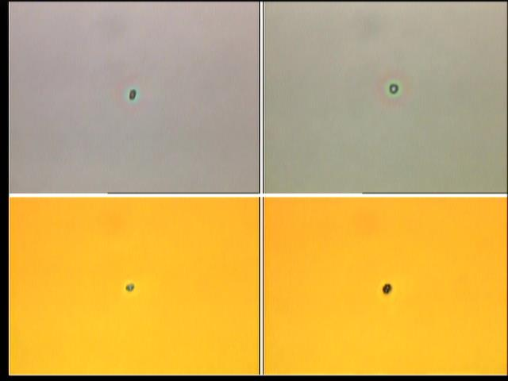
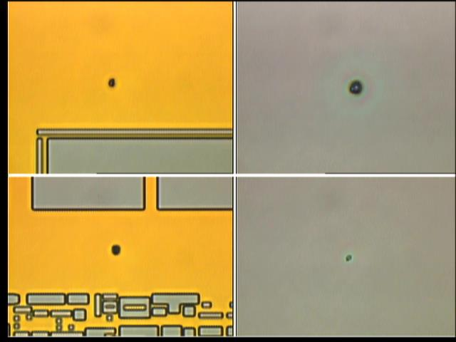
Discipline 2.描述問題及現況掌握Describe the Problem
(WHO detected the problem? WHAT is wrong? State the problem in terms of object and defect. WHERE the problem was first detected, describe location of the detection, lot #, WHEN and HOW it was detected)
PR area
PR area
PR area
PR area
OM check by 偏表層 defect (SiN dep. defect)
蓋光阻區域 defect 有暈 (defect under PR)

Slide 11
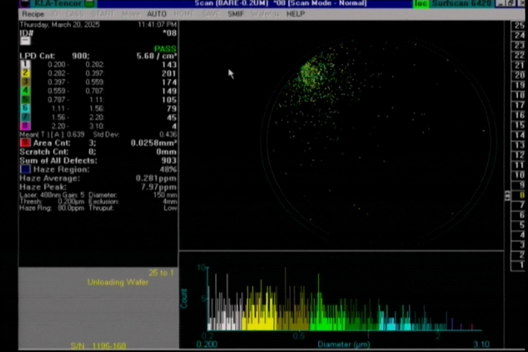
Discipline 2.描述問題及現況掌握Describe the Problem
(WHO detected the problem? WHAT is wrong? State the problem in terms of object and defect. WHERE the problem was first detected, describe location of the detection, lot #, WHEN and HOW it was detected)
25093170/25092960 Do SINRWK PAD前 After B-clean check PTC
25093170 | After B-CLEAN | 25092960 | After B-CLEAN
Wafer ID | PTC | Wafer ID | PTC
25 | 259 | 25 | 86
24 | 57 | 24 | 59
23 | 629 | 23 | 117
22 | 361 | 22 | 42
21 | 287 | 21 | 117
20 | 350 | 20 | 72
19 | 144 | 19 | 38
18 | 467 | 18 | 182
17 | 43 | 17 | 100
16 | 34 | 16 | 71
15 | 264 | 15 | 154
14 | 57 | 14 | 134
13 | 406 | 13 | 118
12 | 32 | 12 | 25
11 | 135 | 11 | 18
10 | 68 | 10 | 136
9 | 57 | 9 | 76
8 | 903 | 8 | 213
7 | 655 | 7 | 178
6 | 532 | 6 | 190
5 | 26 | 5 | 23
4 | 69 | 4 | 38
3 | 565 | 3 | 46
2 | 376 | 2 | 17
1 | 24 | 1 | 18
#8 11 o’clock mapping PTC:903
ALL FH 5002 FOX前 AOI check

Slide 12
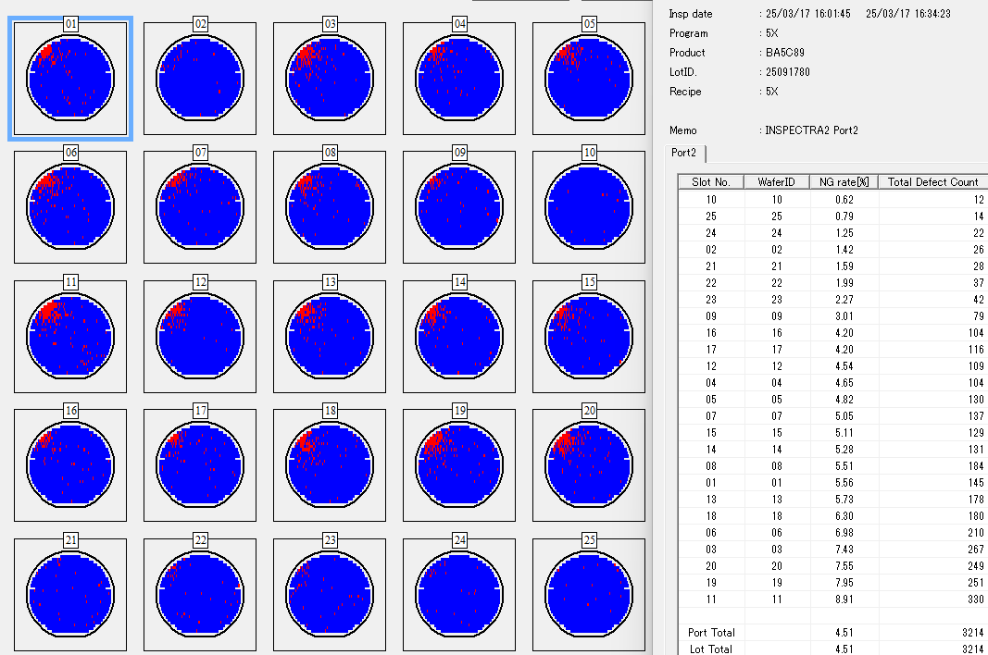
Discipline 2.描述問題及現況掌握Describe the Problem
(WHO detected the problem? WHAT is wrong? State the problem in terms of object and defect. WHERE the problem was first detected, describe location of the detection, lot #, WHEN and HOW it was detected)
AOI - M034DI-BA5C89-25091780-4612
共12片def>5%
5.05~8.91%
25091780-M034DI-BA5C89-4612-op
AOI scan defect rate: 0.62~8.91%
OM check #11 local by SiN dep. defect issue
Product for S200 check

Slide 13
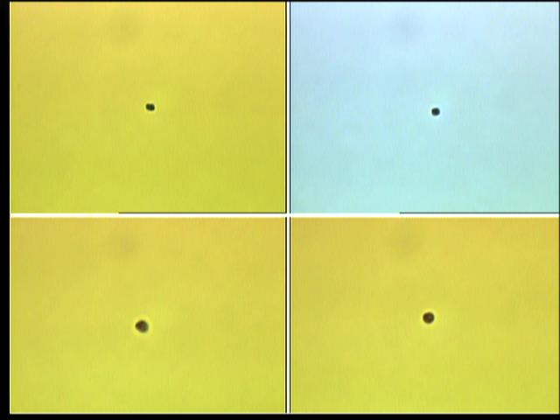
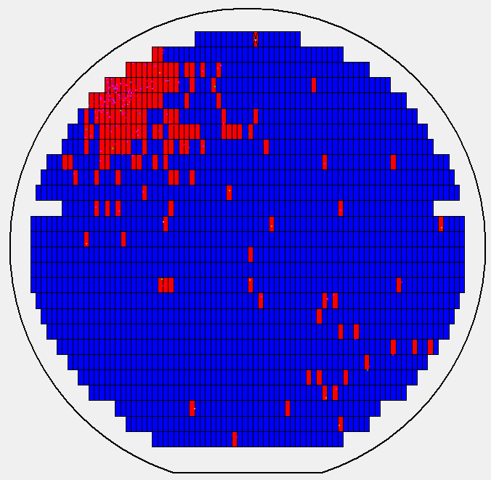
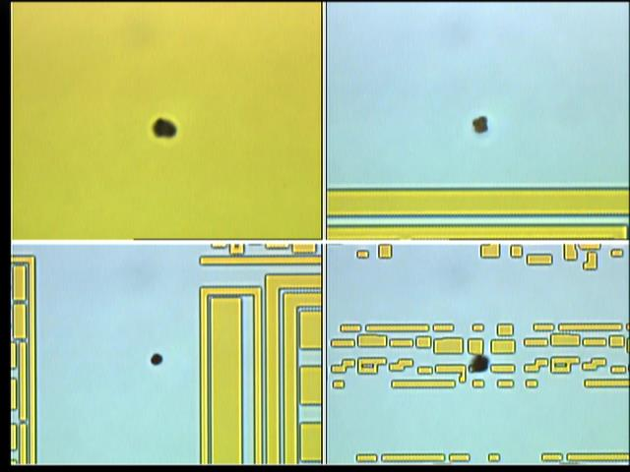
Discipline 2.描述問題及現況掌握Describe the Problem
(WHO detected the problem? WHAT is wrong? State the problem in terms of object and defect. WHERE the problem was first detected, describe location of the detection, lot #, WHEN and HOW it was detected)
#11

Slide 14
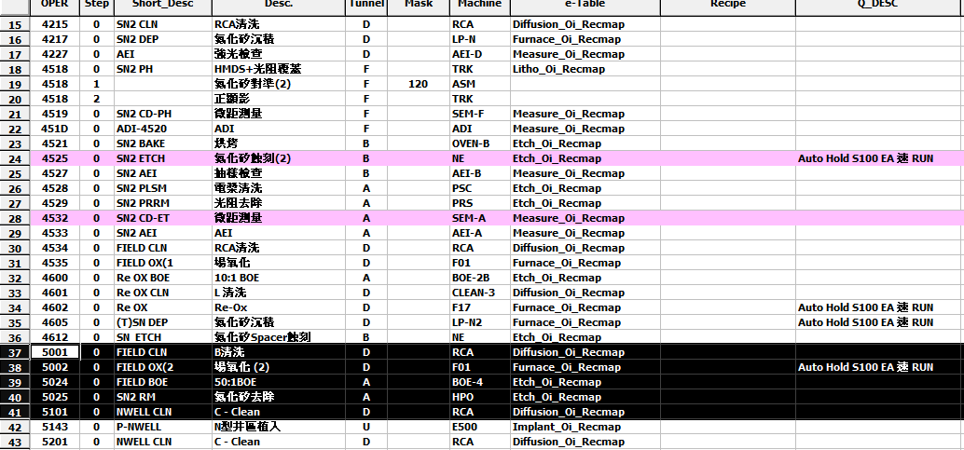
Discipline 2.描述問題及現況掌握Describe the Problem
(WHO detected the problem? WHAT is wrong? State the problem in terms of object and defect. WHERE the problem was first detected, describe location of the detection, lot #, WHEN and HOW it was detected)
目前位置
FH 5143，在5025 SIN去除後AOI re-check

Slide 15
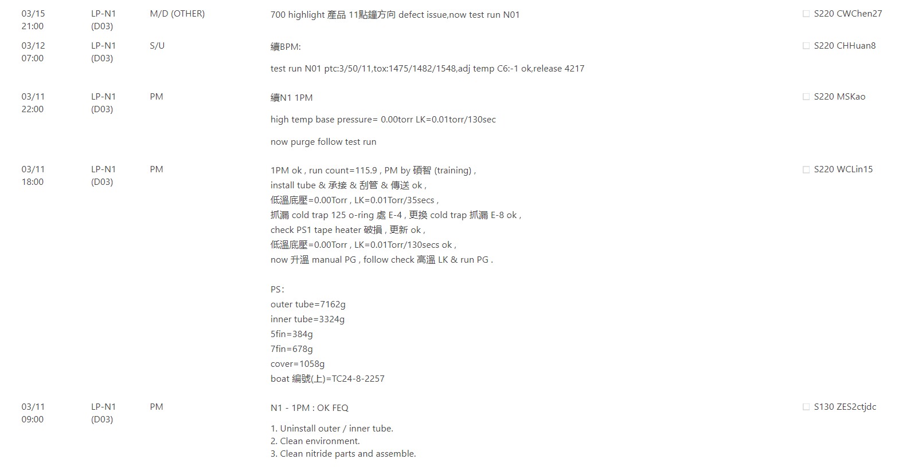
LP-N1 entity records
Discipline 2.描述問題及現況掌握Describe the Problem
(WHO detected the problem? WHAT is wrong? State the problem in terms of object and defect. WHERE the problem was first detected, describe location of the detection, lot #, WHEN and HOW it was detected)
3/11~3/12 BPM
3/12 release LP-N1

Slide 16
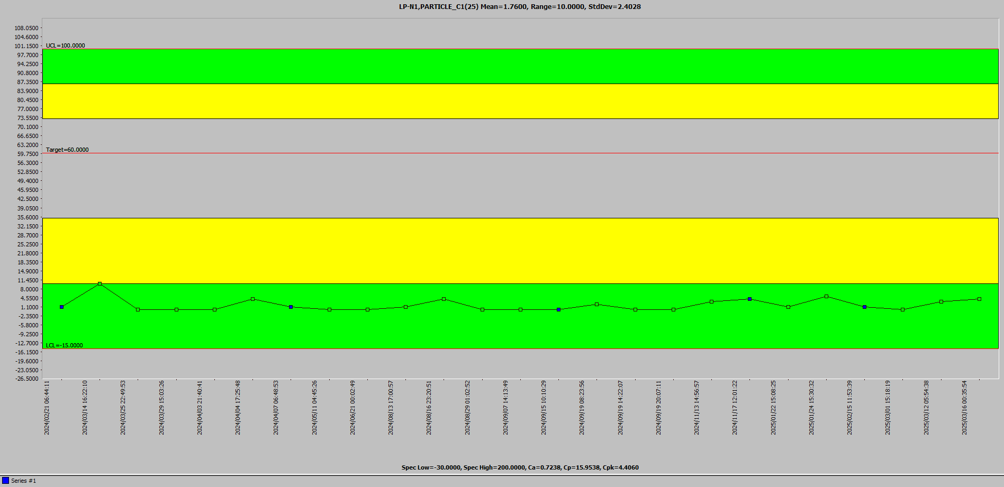
Particle trends of LP-N1
Discipline 2.描述問題及現況掌握Describe the Problem
(WHO detected the problem? WHAT is wrong? State the problem in terms of object and defect. WHERE the problem was first detected, describe location of the detection, lot #, WHEN and HOW it was detected)
C1
3/11~3/12 BPM
normal
2024/2/1~2025/3/16

Slide 17
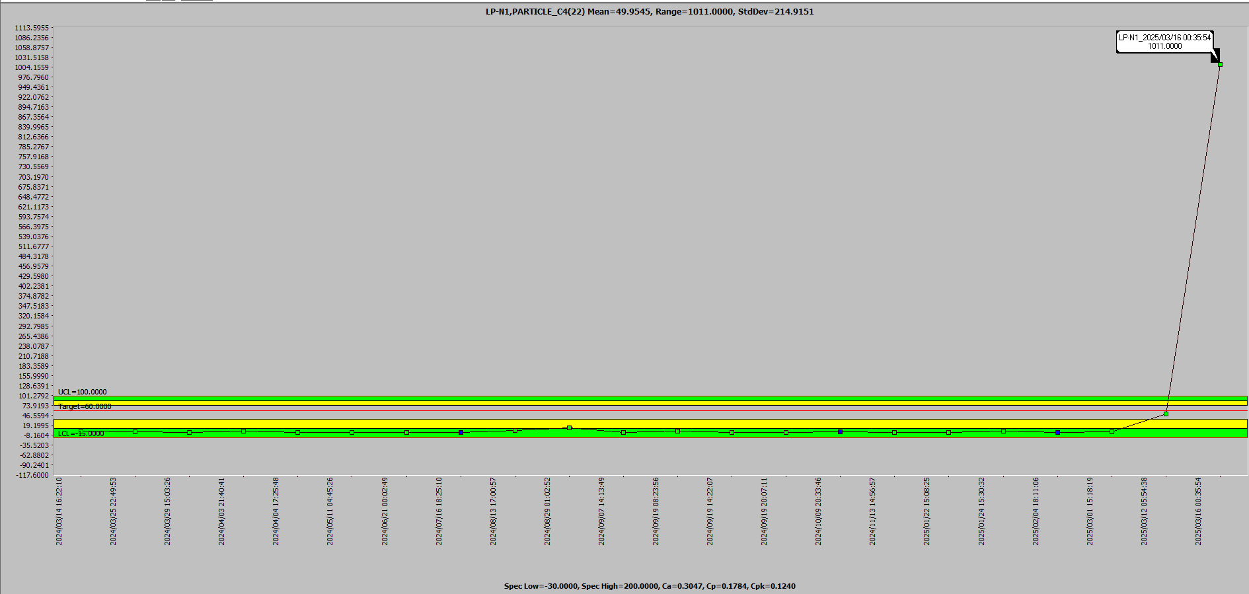
Discipline 2.描述問題及現況掌握Describe the Problem
(WHO detected the problem? WHAT is wrong? State the problem in terms of object and defect. WHERE the problem was first detected, describe location of the detection, lot #, WHEN and HOW it was detected)
C4
3/11~3/12 BPM
Date & Time | Particle count
Long-term avg. | 2
LP-N1_2025/03/12 05:54:38 | 50
LP-N1_2025/03/16 00:35:54 | 1011
2024/2/1~2025/3/16

Slide 18
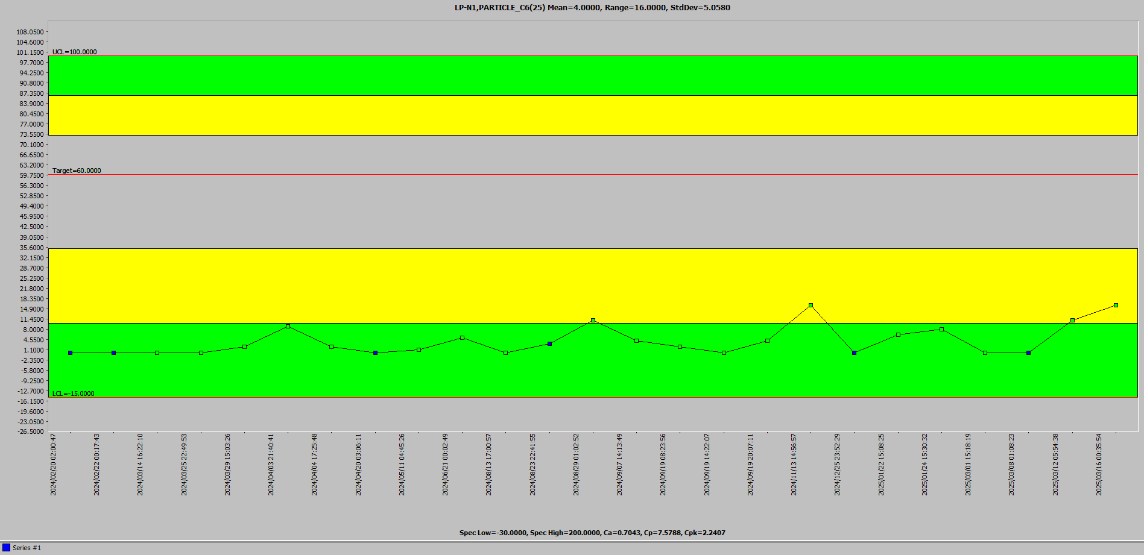
Discipline 2.描述問題及現況掌握Describe the Problem
(WHO detected the problem? WHAT is wrong? State the problem in terms of object and defect. WHERE the problem was first detected, describe location of the detection, lot #, WHEN and HOW it was detected)
C6
3/11~3/12 BPM
normal
2024/2/1~2025/3/16

Slide 19
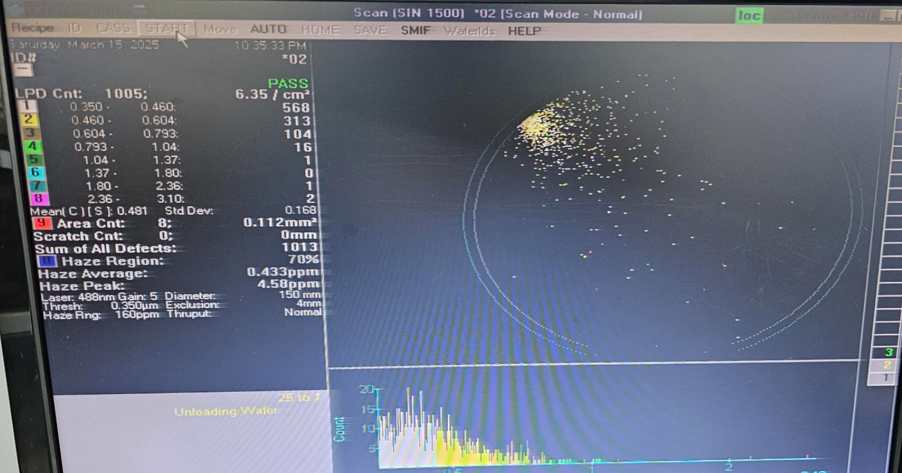
S.S. map
Discipline 2.描述問題及現況掌握Describe the Problem
(WHO detected the problem? WHAT is wrong? State the problem in terms of object and defect. WHERE the problem was first detected, describe location of the detection, lot #, WHEN and HOW it was detected)
LP-N1 C4 at 3/16 00:35
It’s same defect map with the product.

Slide 20
Discipline 2.描述問題及現況掌握Describe the Problem
Is/Is Not Analysis table (釐清問題):
 |  | Is | Is Not | Difference/Conclusion
What | Object | Particle OOS | Normal | Particle OOS
 | Defect | 11 o’clock defect | Normal | 11 o’clock defect
Where | Location | FAB D-Tunnel | Other place | FAB D-Tunnel
 | Machine | LP-N1 | NA | Other machine
When | First time | 2025/3/12 | Not before | First time, Not Before
 | Reoccurred | - | - | NA
How | Many | 78 lots / 1912 pcs | Other lot | 78 lots / 1912 pcs
 | Trend | - | - | NA

Slide 21
Discipline 3.執行及驗證暫時防堵對策 Contain the Problem
(Define and implement containment actions to isolate the effect of problem from any internal/external customer until corrective action is implemented)
3.1 異常產品 (Defect Lots)
項目 Item | 處理方式 Action | 負責人員 Resp | 預定完成日 Due | 實際完成日 Imp. | 處理結果 Verification
25091780 | AOI scan | S210 | 2025/03/28 | 2025/03/28 | Scrap 4 pcs, def. >5%
25091270 |  |  |  |  | Scrap 10 pcs, def. >5%
25093140 |  |  |  |  | Scrap 1 pcs, def. >5%
25091890 |  |  |  |  | Scrap 18 pcs, def. >5%
25091580 |  |  |  |  | Scrap 7 pcs, def. >5%
25093170 |  |  |  |  | Scrap 1 pcs, def. >5%
25101360 |  |  |  |  | Scrap 1 pcs, def. >5%

Slide 22
3.2 波及產品 (Impact Lots)
LOT ENTITY INFORMATION |  |  |  |  |  |  |  | AOI INFORMATION
LOT | Move-in time | OPERATION | Recipe | Zone | PRODUCT | ROUTE | QTY | PROGRAM | AOI SCAN OPER | Note
25096810 | 3/10/2025 19:42 | 4217 | LN1N01 | 1 | YBF01V | T054DI | 25
25097390 | 3/10/2025 19:42 | 4217 | LN1N01 | 2 | YBF01V | T054DI | 25 | 5X | 4533 (0% ~ 0.24%)
25096850 | 3/10/2025 19:42 | 4217 | LN1N01 | 3 | YBF01V | T054DI | 25
25097410 | 3/10/2025 19:42 | 4217 | LN1N01 | 4 | YBD24V | T050QI | 25 | 5X | 4533 (0.01% ~ 0.04%)
25097650 | 3/10/2025 19:42 | 4217 | LN1N01 | 5 | YBD04V | T054NI | 25 | 5X | 4533 (0.03% ~ 0.92%)
25092230 | 3/10/2025 19:42 | 4217 | LN1N01 | 6 | BA5D25 | M030TIK | 25 | 5X | 4533 (0% ~ 0.16%)
BPM
25092830 | 3/12/2025 6:35 | 4217 | LN1N01 | 1 | BA5D26 | M030TIK | 25 | 5X | 4533 (0.03% ~ 0.57%)
25092780 | 3/12/2025 6:35 | 4217 | LN1N01 | 2 | BA5D26 | M030TIK | 25 | 5X | 4518 (0.07% ~ 1.51%) | Impact lot
25092980 | 3/12/2025 6:35 | 4217 | LN1N01 | 3 | BA5D26 | M030TIK | 25 | 5X | 4533 (0.03% ~ 0.91%) | Impact lot
25091920 | 3/12/2025 6:35 | 4217 | LN1N01 | 4 | BA5B78 | M034GIK | 25
25092520 | 3/12/2025 6:35 | 4217 | LN1N01 | 5 | BA5C46 | M034KIK | 25
25110180 | 3/12/2025 6:35 | 4217 | LN1N01 | 6 | Y0S013 | C035DI | 25 | 5X | 4533 (0% ~ 0.01%)
25092580 | 3/12/2025 13:00 | 4217 | LN1N01 | 1 | BA5C46 | M034KIK | 25
25109130 | 3/12/2025 13:00 | 4217 | LN1N01 | 2 | YHAK1S | O0315I | 4
25093010 | 3/12/2025 13:00 | 4217 | LN1N01 | 3 | BA5D26 | M030TIK | 25 | 5x | 5502(0.07~0.57%)
25092960 | 3/12/2025 13:00 | 4217 | LN1N01 | 4 | BA5D26 | M030TIK | 25 | 5X | 4518 (0.1% ~ 4.58%) | Issue lot
25092940 | 3/12/2025 13:00 | 4217 | LN1N01 | 5 | BA5D26 | M030TIK | 25
25091770 | 3/12/2025 13:00 | 4217 | LN1N01 | 6 | BA5C89 | M034DIK | 25
25092970 | 3/12/2025 18:38 | 4217 | LN1N01 | 1 | BA5D26 | M030TIK | 25 | 5X | 4518 (0% ~ 1.38%) | Impact lot
25092170 | 3/12/2025 18:38 | 4217 | LN1N01 | 2 | BA5B91 | M034GIK | 25
25092640 | 3/12/2025 18:38 | 4217 | LN1N01 | 3 | BA5C09 | M030TIK | 25 | 5x | 5747 (0.26~1.64%)
25091780 | 3/12/2025 18:38 | 4217 | LN1N01 | 4 | BA5C89 | M034DIK | 25 | 5x | 5143 (0.46~7.61%)
25091760 | 3/12/2025 18:38 | 4217 | LN1N01 | 5 | BA5C89 | M034DIK | 25 | 5X | 4533 (0.12% ~ 2.13%) | Impact lot
25095120 | 3/12/2025 18:38 | 4217 | LN1N01 | 6 | RC5C86 | A061TI | 25
25091910 | 3/13/2025 0:49 | 4217 | LN1N01 | 1 | BA5B78 | M034GIK | 25
25091790 | 3/13/2025 0:49 | 4217 | LN1N01 | 2 | BA5C89 | M034DIK | 25
25091870 | 3/13/2025 0:49 | 4217 | LN1N01 | 3 | BA5B78 | M034GIK | 25
25091270 | 3/13/2025 0:49 | 4217 | LN1N01 | 4 | BA5C99 | M034AIK | 25
25093230 | 3/13/2025 0:49 | 4217 | LN1N01 | 5 | BA5D26 | M030TIK | 25
25093120 | 3/13/2025 0:49 | 4217 | LN1N01 | 6 | BA5D26 | M030TIK | 25

Slide 23
25091400 | 3/13/2025 5:56 | 4217 | LN1N01 | 1 | BA5C99 B | M034AIK | 25
25101280 | 3/13/2025 5:56 | 4217 | LN1N01 | 2 | Y1F058001 AA | C061YI | 25
25101360 | 3/13/2025 5:56 | 4217 | LN1N01 | 3 | Y1F058001 AA | C061YI | 25 |  | FU 6183 AOI確認
25101270 | 3/13/2025 5:56 | 4217 | LN1N01 | 4 | Y1F058001 AA | C061YI | 25 | 5x | 5001 (1~12.75%)
25101370 | 3/13/2025 5:56 | 4217 | LN1N01 | 5 | Y1F058001 AA | C061YI | 25
25101250 | 3/13/2025 5:56 | 4217 | LN1N01 | 6 | Y1F058001 AA | C061YI | 25
25093030 | 3/13/2025 12:36 | 4217 | LN1N01 | 1 | BA5D26 A | M030TIK | 25
25091850 | 3/13/2025 12:36 | 4217 | LN1N01 | 2 | BA5B78 D | M034GIK | 25
25093140 | 3/13/2025 12:36 | 4217 | LN1N01 | 3 | BA5D26 A | M030TIK | 25 | 5x | 4612 (0.41~4.15%)
25091890 | 3/13/2025 12:36 | 4217 | LN1N01 | 4 | BA5B78 D | M034GIK | 25
25091650 | 3/13/2025 12:36 | 4217 | LN1N01 | 5 | BA5C98 D | M034KIK | 25
25091620 | 3/13/2025 12:36 | 4217 | LN1N01 | 6 | BA5C98 D | M034KIK | 25
25091900 | 3/13/2025 18:07 | 4217 | LN1N01 | 1 | BA5B78 D | M034GIK | 25
25091370 | 3/13/2025 18:07 | 4217 | LN1N01 | 2 | BA5C99 B | M034AIK | 25
25092090 | 3/13/2025 18:07 | 4217 | LN1N01 | 3 | BA5B71 F | M034GIK | 25 | 5x | 5201 (0.34~4.86%)
25091580 | 3/13/2025 18:07 | 4217 | LN1N01 | 4 | BA5C98 D | M034KIK | 25 | 5x | 5001 (0.15~8.35%)
25092790 | 3/13/2025 18:07 | 4217 | LN1N01 | 5 | BA5D26 A | M030TIK | 25
25093100 | 3/13/2025 18:07 | 4217 | LN1N01 | 6 | BA5D26 A | M030TIK | 25
25102560 | 3/13/2025 23:33 | 4217 | LN1N01 | 1 | Y5Y08Y W | G0414I | 25
25102010 | 3/13/2025 23:33 | 4217 | LN1N01 | 2 | Y4Y028 L | D0665I | 25
25102740 | 3/13/2025 23:33 | 4217 | LN1N01 | 3 | Y5Y10Y G | L041SI | 25
25102310 | 3/13/2025 23:33 | 4217 | LN1N01 | 4 | Y5Y038 F | G061AI | 25
25102500 | 3/13/2025 23:33 | 4217 | LN1N01 | 5 | Y5Y08Y W | G0414I | 25 | 5X | 4533 (0.01% ~ 0.52%) | Impact lot
25102240 | 3/13/2025 23:33 | 4217 | LN1N01 | 6 | Y5Y038 I | G061AI | 25
25102580 | 3/14/2025 4:51 | 4217 | LN1N01 | 1 | Y5Y10Y L | L041SI | 24
25110170 | 3/14/2025 4:51 | 4217 | LN1N01 | 2 | Y5V023 A | L031VI | 25
25102220 | 3/14/2025 4:51 | 4217 | LN1N01 | 3 | Y5Y038 I | G061AI | 25
25102430 | 3/14/2025 4:51 | 4217 | LN1N01 | 4 | Y5Y08Y K | A0412I | 25 | 5X | 4533 (0.01% ~ 0.91%) | Impact lot
25102540 | 3/14/2025 4:51 | 4217 | LN1N01 | 5 | Y5Y08Y W | G0414I | 25
25119020 | 3/14/2025 4:51 | 4217 | LN1N01 | 6 | YA7K43 A | A031WI | 9
25091360 | 3/14/2025 10:07 | 4217 | LN1N01 | 1 | BA5C99 B | M034AIK | 25
25092120 | 3/14/2025 10:07 | 4217 | LN1N01 | 2 | BA5B71 F | M034GIK | 25
25095150 | 3/14/2025 10:07 | 4217 | LN1N01 | 3 | RC5C86 B | A061TI | 25 | 10x | 6182 (0.94~4.60%)
25093170 | 3/14/2025 10:07 | 4217 | LN1N01 | 4 | BA5D26 A | M030TIK | 25 | 5x | 4534(0.1~7.44%)
25091450 | 3/14/2025 10:07 | 4217 | LN1N01 | 5 | BA5C99 B | M034AIK | 25
25091730 | 3/14/2025 10:07 | 4217 | LN1N01 | 6 | BA5C89 E | M034DIK | 25

Slide 24
25094990 | 3/14/2025 15:31 | 4217 | LN1N01 | 1 | RC5C86 B | A061TI | 25
25094950 | 3/14/2025 15:31 | 4217 | LN1N01 | 2 | RC5C86 B | A061TI | 25
25094940 | 3/14/2025 15:31 | 4217 | LN1N01 | 3 | RC5C86 B | A061TI | 25
25093320 | 3/14/2025 15:31 | 4217 | LN1N01 | 4 | BA5C05 E | M030TIK | 25
25095130 | 3/14/2025 15:31 | 4217 | LN1N01 | 5 | RC5C86 B | A061TI | 25
25095170 | 3/14/2025 15:31 | 4217 | LN1N01 | 6 | RC5C86 B | A061TI | 25
25093980 | 3/14/2025 21:01 | 4217 | LN1N01 | 1 | Y2V01W A | T041SI | 25 | 5x | 4561(0~0.23%)
25102170 | 3/14/2025 21:01 | 4217 | LN1N01 | 2 | Y5Y02X B | D041KI | 25
25102270 | 3/14/2025 21:01 | 4217 | LN1N01 | 3 | Y5Y028 F | G061AI | 25
25094030 | 3/14/2025 21:01 | 4217 | LN1N01 | 4 | Y2V01W A | T041SI | 25 | 5x | 4561(0.02~0.5%)
25094020 | 3/14/2025 21:01 | 4217 | LN1N01 | 5 | Y2V01W A | T041SI | 25
25102780 | 3/14/2025 21:01 | 4217 | LN1N01 | 6 | Y5Y10Y G | L041SI | 25 | 5x | 4538(0.01~0.03%)
25111470 | 3/15/2025 8:09 | 4217 | LN1N01 | 1 | Y1P492 B | C030CIK | 25 | 5x | 4533(0.01~0.03%)
25111230 | 3/15/2025 8:09 | 4217 | LN1N01 | 2 | YCP06X A | P046PI | 25
25111310 | 3/15/2025 8:09 | 4217 | LN1N01 | 3 | Y1P483 C | M030GIK | 25
25111450 | 3/15/2025 8:09 | 4217 | LN1N01 | 4 | Y1P482 B | C030CIK | 25 | 5X | 4521(0~0.15%)
25111120 | 3/15/2025 8:09 | 4217 | LN1N01 | 5 | YCP06X A | P046PI | 25
25111400 | 3/15/2025 8:09 | 4217 | LN1N01 | 6 | Y1P482 B | C030CIK | 25 | 5X | 4521(0.01~0.05%)
On 3/15, LP-N1 停機

Slide 25
Discipline 3.執行及驗證暫時防堵對策 Contain the Problem
(Define and implement containment actions to isolate the effect of problem from any internal/external customer until corrective action is implemented)
3.3 波及設備 (Impact Machine)
項目 Item | 處理方式 Action | 負責人員 Resp | 預定完成日 Due | 實際完成日 Imp. | 處理結果 Verification
LP-N1 | 停機檢查 | S220 林韋志 | 2025/03/16 | 2025/03/16 | Check 轉子異常抖動， 更換轉子
3.4 波及製程 (Impact Route) : 是(YES)/否(No)
項目 Item | 處理方式 Action | 負責人員 Resp | 預定完成日 Due | 實際完成日 Imp. | 處理結果 Verification
3.5 產品召回選項，是否需進行客戶端波及產品的召回?是(YES)/否(No)
Customer | Product No. | Lot number / Wafer number | Approx. Quantity

Slide 26
Discipline 4.定義及驗證真因 (Identify the Root Cause)
(Identify all potential causes which could explain why the problem occurred)
4.1 Non-conformance root cause (defect nature / technical root cause):
a) Failure mechanism:
S730 Highlight 產品有11點鐘方向defect 直接test run N01 PTC = 4/1011/16 C4 OOS ，機台停機進行檢查。

Slide 27
Discipline 4.定義及驗證真因 (Identify the Root Cause)
(Identify all potential causes which could explain why the problem occurred)
4.1 Non-conformance root cause (defect nature / technical root cause):
b) 列出所有可能的原因 (Probable Causes/Factors): Non-conformance
工具 (Tools): 故障樹分析 (Fault Tree Analysis)、魚骨圖 (Fishbone)
傳送相關
環境因素
轉子
爐管外
刮傷
爐管內
刮管
PTC OOS可能原因
Tube
vent
Pedestal
Boat
pump
APC
Injector
石英相關
壓力異常

Slide 28
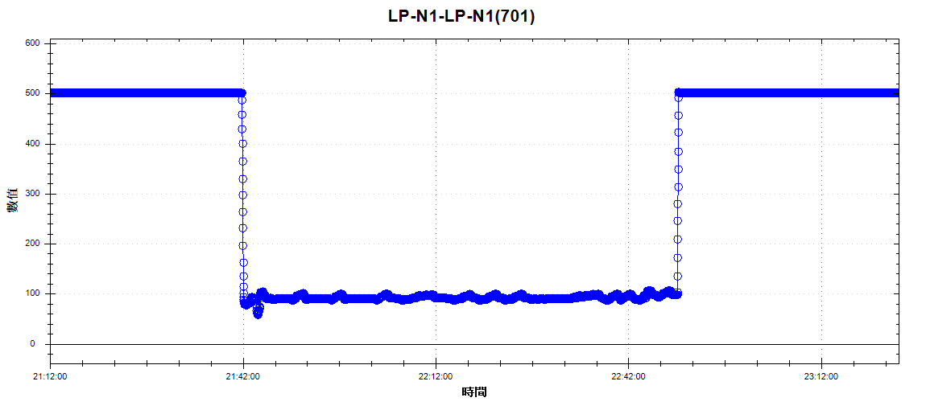
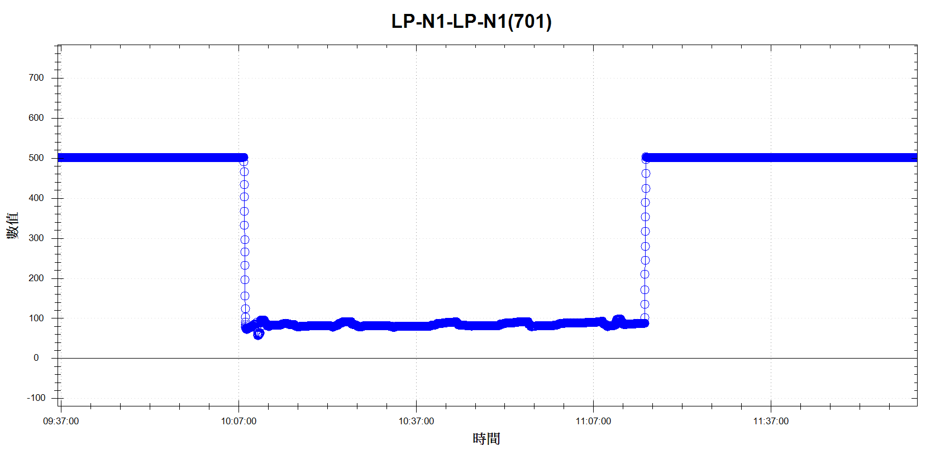
Discipline 4.定義及驗證真因 (Identify the Root Cause)
(Identify all potential causes which could explain why the problem occurred)
vent
4.1 Non-conformance root cause (defect nature / technical root cause):
c) 真因驗證 (Root Cause Verification)
pump
APC
壓力異常
2025/03/12 BPM前
2025/03/12 BPM後
Check APC角度，相較於BPM前無明顯異常 因為進行過BPM，APC角度變化反而更加穩定，非真因

Slide 29
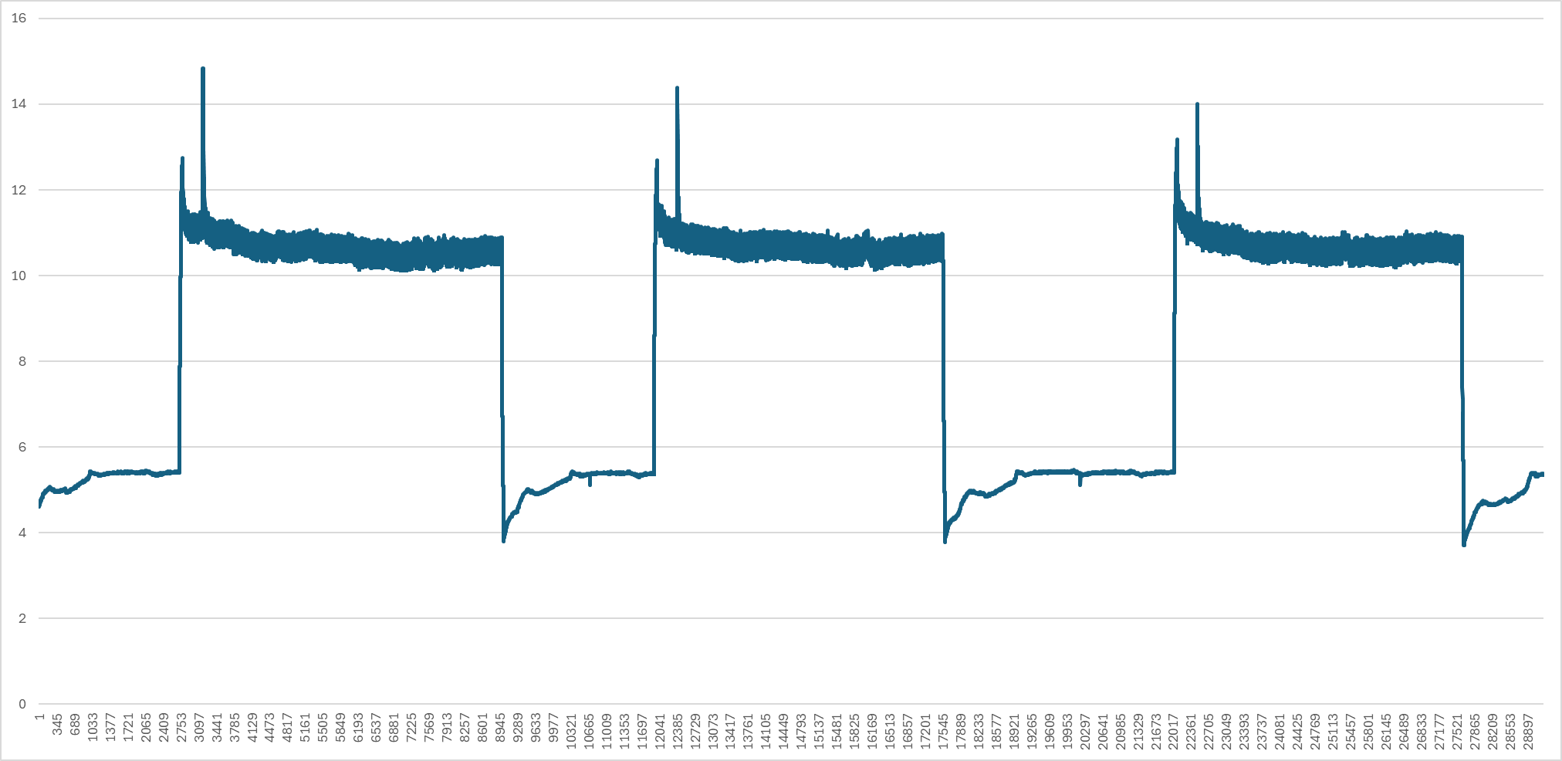
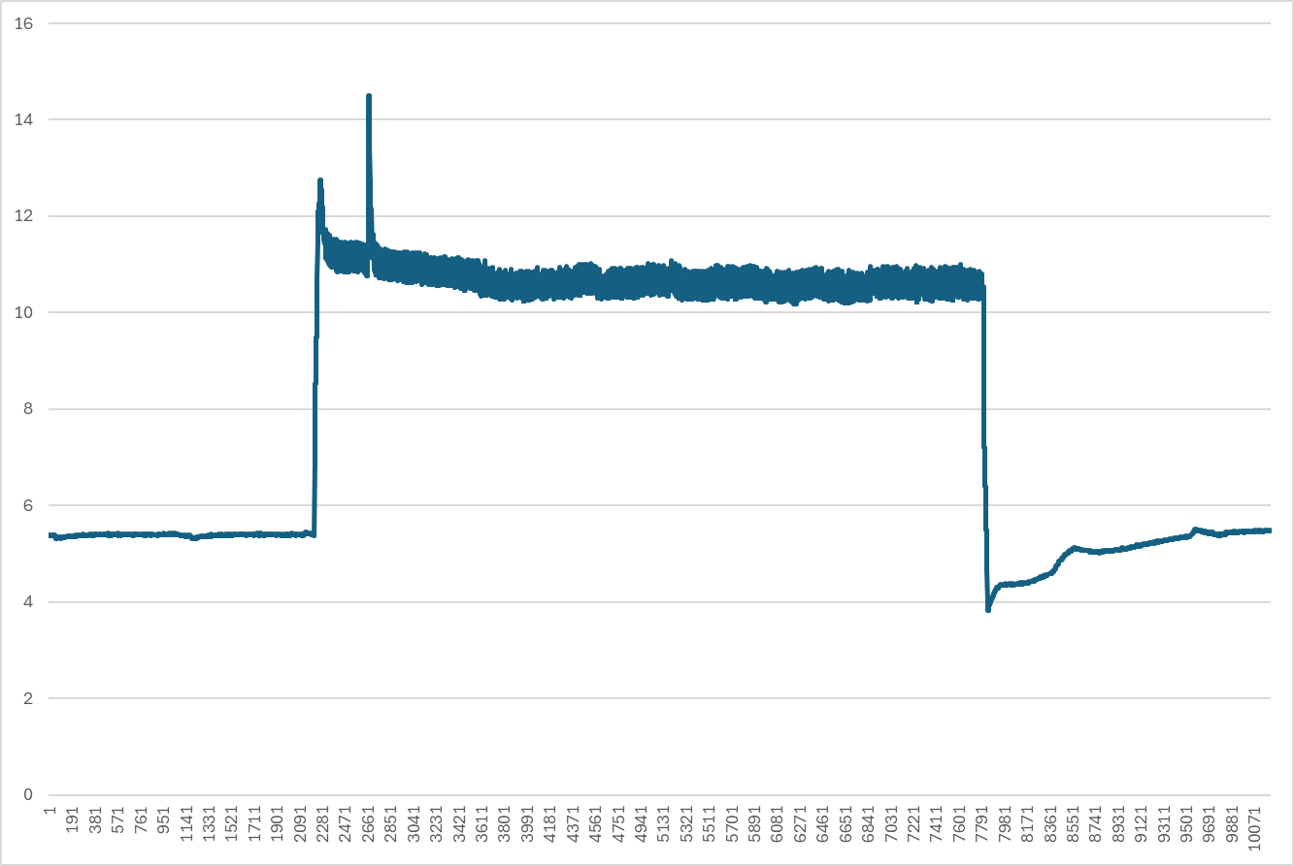
Discipline 4.定義及驗證真因 (Identify the Root Cause)
(Identify all potential causes which could explain why the problem occurred)
vent
4.1 Non-conformance root cause (defect nature / technical root cause):
c) 真因驗證 (Root Cause Verification)
pump
APC
壓力異常
2025/03/12 BPM前
Pump down 瞬間
2025/03/12 BPM後
Check pump電流穩定10A~11A，相較BPM前無明顯異狀，非真因
Check vent 破真空氣聲正常，非真因

Slide 30
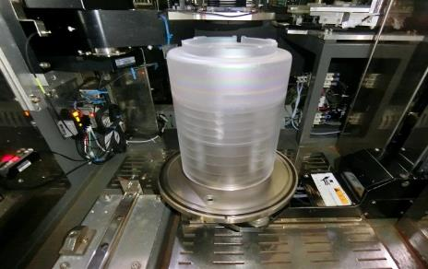
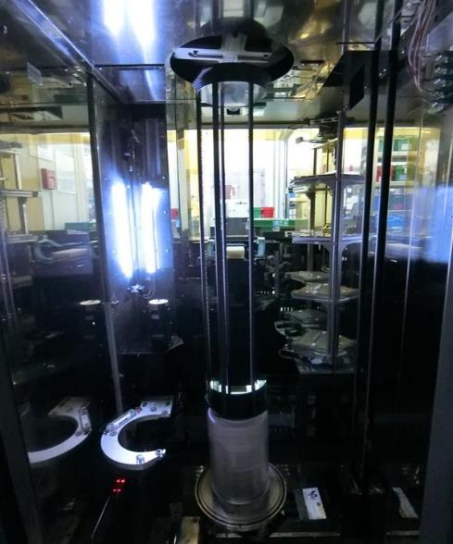
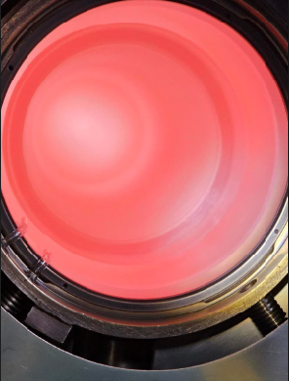
Discipline 4.定義及驗證真因 (Identify the Root Cause)
(Identify all potential causes which could explain why the problem occurred)
Tube
Pedestal
4.1 Non-conformance root cause (defect nature / technical root cause):
c) 真因驗證 (Root Cause Verification)
Boat
Injector
石英相關
Cap & 保溫筒 no powder
Quartz Tube 無破損
Boat no powder
Check 石英、Boat無破損，機台內無粉末 ，非真因

Slide 31
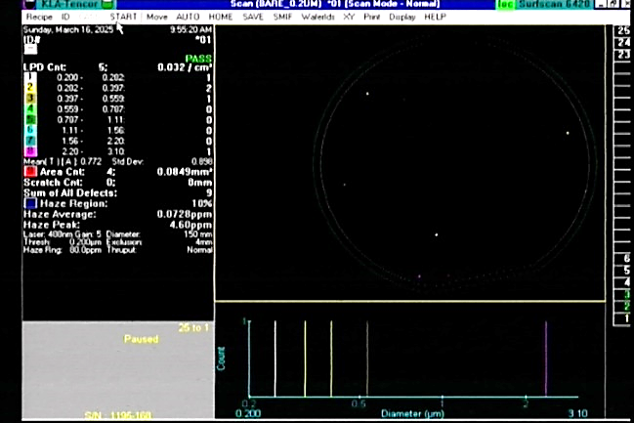
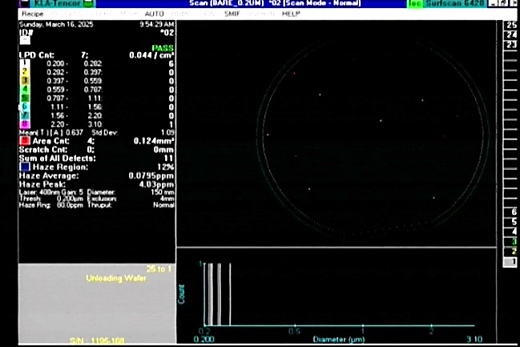
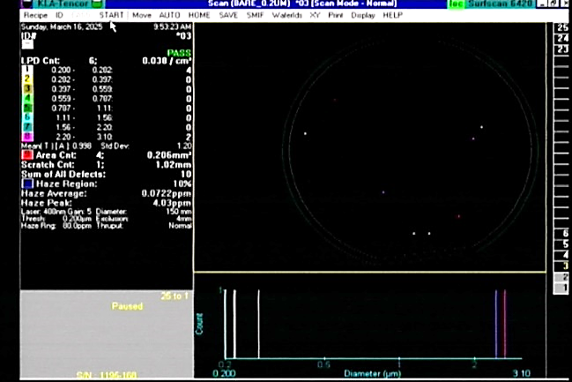
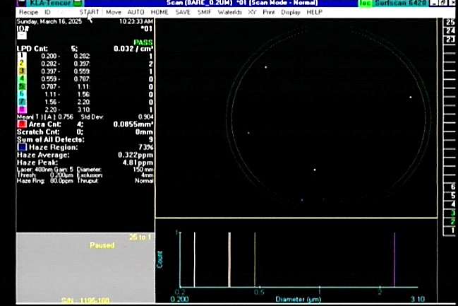
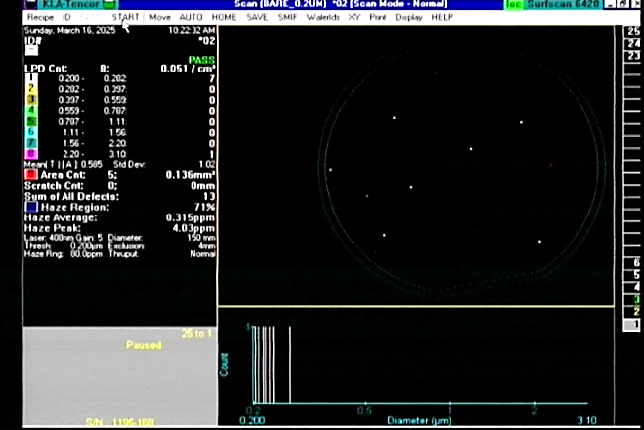
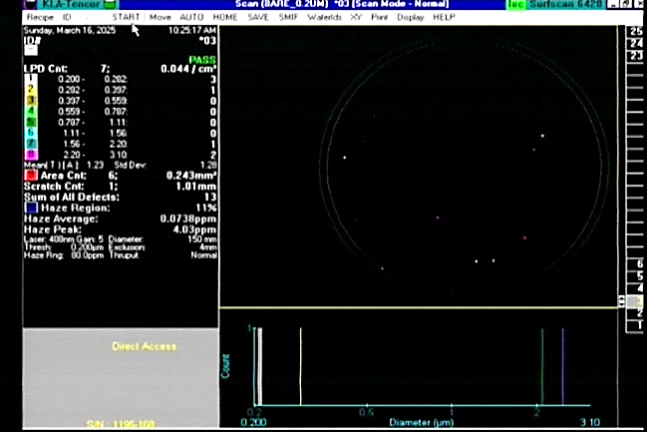
環境因素
Discipline 4.定義及驗證真因 (Identify the Root Cause)
(Identify all potential causes which could explain why the problem occurred)
爐管外
爐管內
4.1 Non-conformance root cause (defect nature / technical root cause):
c) 真因驗證 (Root Cause Verification)
Slot 005
Slot 096
Slot 157
爐外環境 : load M/W 承接後靜置 20分鐘，PTC=1/4/2，非真因
Slot 005
Slot 096
Slot 157
爐內環境 : load M/W 承接後旋轉 20分鐘，PTC=0/2/4，非真因

Slide 32
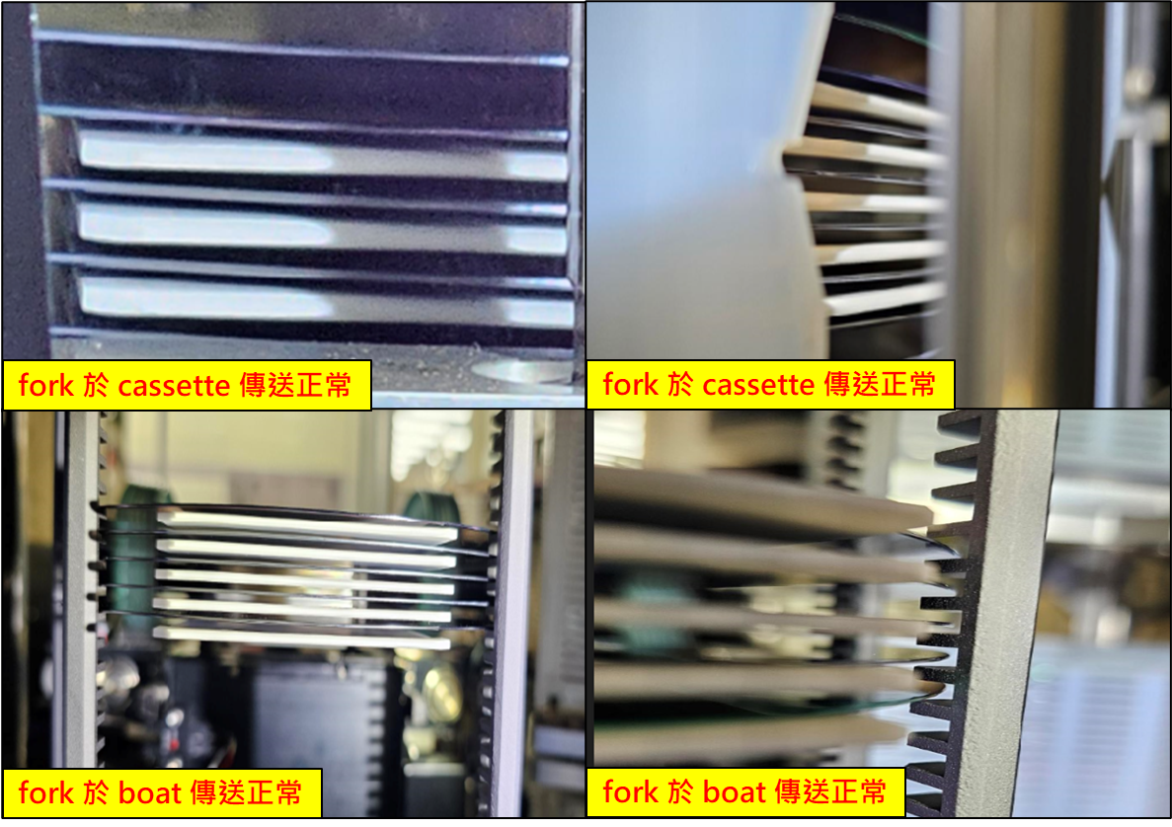
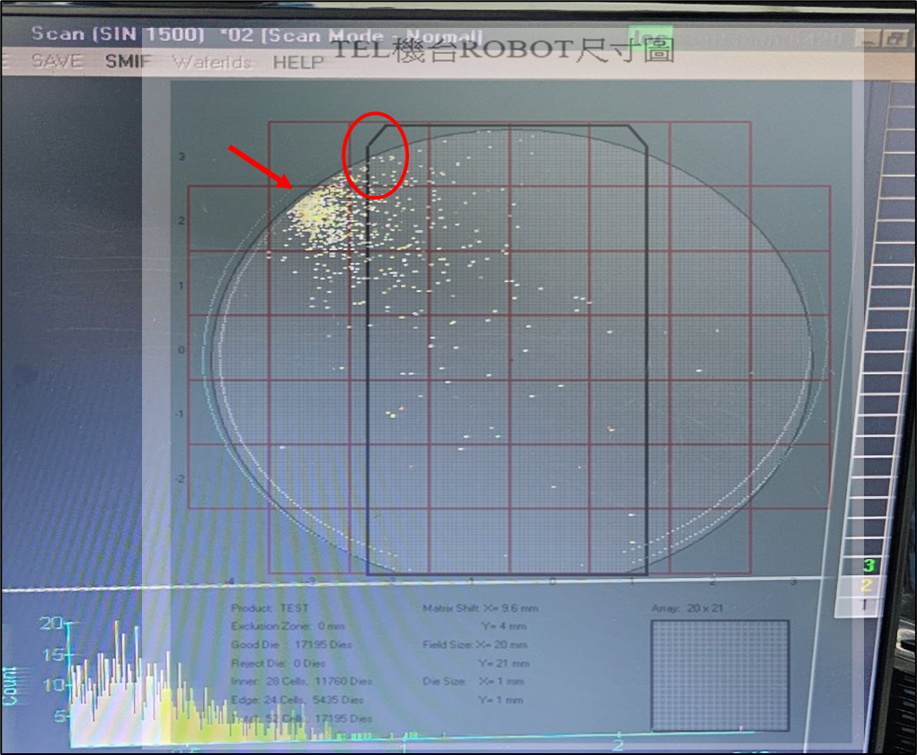
傳送相關
Discipline 4.定義及驗證真因 (Identify the Root Cause)
(Identify all potential causes which could explain why the problem occurred)
轉子
刮傷
4.1 Non-conformance root cause (defect nature / technical root cause):
c) 真因驗證 (Root Cause Verification)
刮管
cassette 端 & boat 端傳送均正常，且PTC map與fork位置不相符，非真因

Slide 33
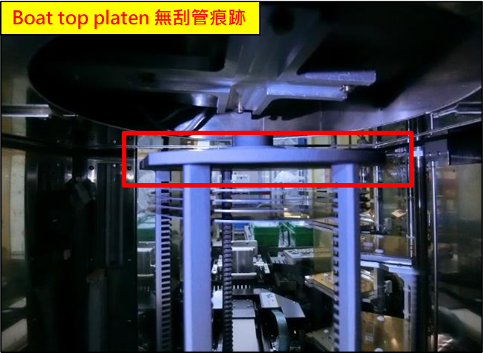
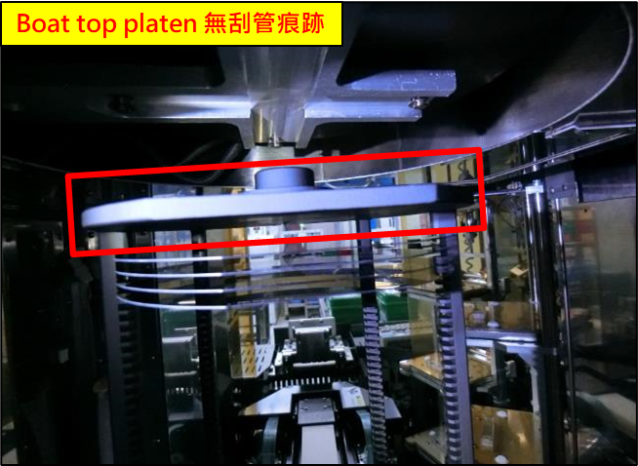
傳送相關
Discipline 4.定義及驗證真因 (Identify the Root Cause)
(Identify all potential causes which could explain why the problem occurred)
轉子
刮傷
4.1 Non-conformance root cause (defect nature / technical root cause):
c) 真因驗證 (Root Cause Verification)
刮管
Boat無刮管痕跡，非真因

Slide 34
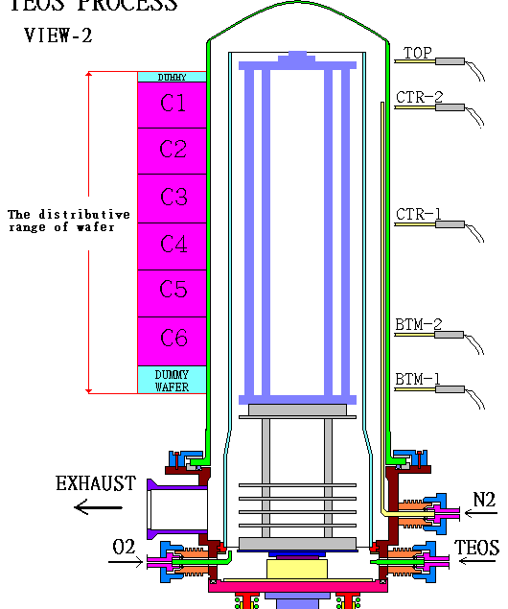
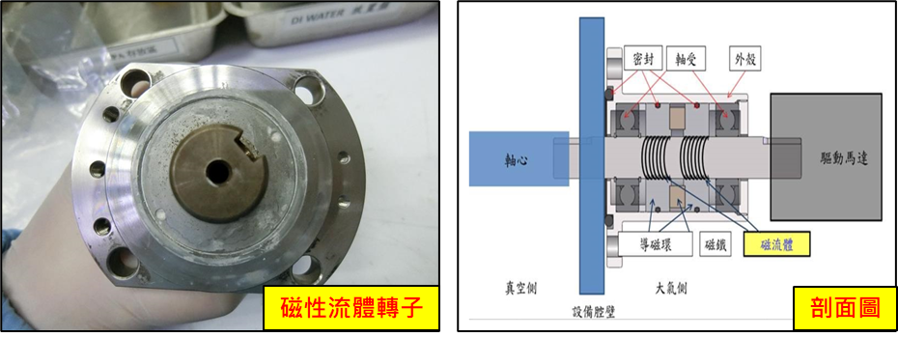
傳送相關
Discipline 4.定義及驗證真因 (Identify the Root Cause)
(Identify all potential causes which could explain why the problem occurred)
轉子
刮傷
4.1 Non-conformance root cause (defect nature / technical root cause):
c) 真因驗證 (Root Cause Verification)
刮管
磁性流體轉子
轉子旋轉時用手摸有震動，卸載轉子後手轉皮帶卡頓。
Nitride製程反應生成物較多，須於BPM時拆下清潔，此製程的轉子較容易會出現問題

Slide 35
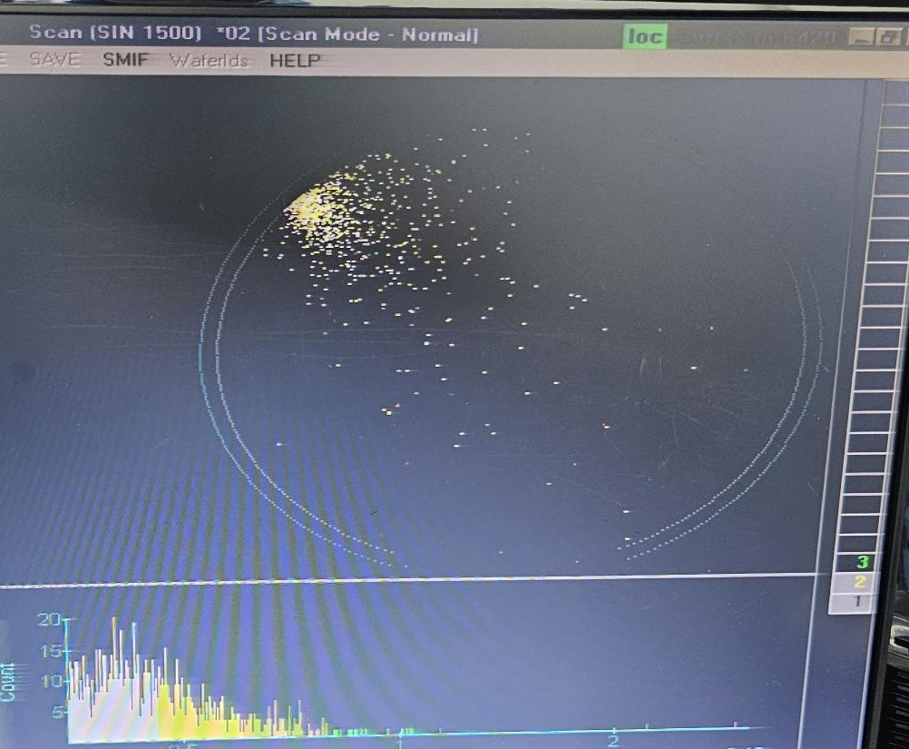

傳送相關
Discipline 4.定義及驗證真因 (Identify the Root Cause)
(Identify all potential causes which could explain why the problem occurred)
轉子
刮傷
4.1 Non-conformance root cause (defect nature / technical root cause):
c) 真因驗證 (Root Cause Verification)
刮管
Boat pitch
對比 PTC map，particle位置與 boat pitch位置符合
轉子因轉動不順而抖動，讓wafer與boat pitch接觸摩擦產生particle，為真因

Slide 36
Discipline 4.定義及驗證真因 (Identify the Root Cause)
(Identify all potential causes which could explain why the problem occurred)
4.1 Non-conformance root cause (defect nature / technical root cause):
d) 5-Why analysis
Why S730 於 2025/03/15 highlight LP-N1 ?
因為LP-N1 於 2025/03/12~2025/03/15 發現多批 11 o’clock PTC defect
Why 出現多批 PTC defect ?
因為機台有particle問題, 直接test run C4 PTC = 1011 OOS
Why 機台有particle問題 ?
因為轉子異常抖動，wafer與boat摩擦產生particle
Why 轉子發生異常抖動?
因為此製程反應生成物較多，造成轉子卡頓
b) Conclusion：
更換轉子

Slide 37
Discipline 4.定義及驗證真因 (Identify the Root Cause)
(Identify all potential causes which could explain why the problem occurred)
4.2 Non-detection / escape root cause (Provide reason to why the current system failed to detect)
a) 5-why:
Why 轉子卡頓無法預防
因為轉子使用至出現異常才會做更換
b) Conclusion
定期更換轉子

Slide 38
Discipline 5.擬定及驗證永久改善對策Choose and verify permanent corrective action (列出各項執行之對策並檢核其對策有效性)
5.1 What was the chosen corrective action to correct the root cause? (Add photo or diagram where applicable.)
LP-N1 Replace 轉子
訂定LP-N機組轉子更換週期

Slide 39
Discipline 5.擬定及驗證永久改善對策Choose and verify permanent corrective action (列出各項執行之對策並檢核其對策有效性)
5.2 Verification of actions effectiveness
LP-N1 轉子更換後 1st test run N01 ADD 6M/W, TOX =1493/1500/1494, PTC = 0/0/0/0/0/16
2nd test run N01 ADD 3M/W, TOX = 1487/1497/1503, PTC = 0/0/4
Data in control

Slide 40
Discipline 6.實施認永久改善對策Corrective Actions Implementation
6.1 For non-conformance root cause (defect nature / technical root cause):
Nbr. | Actions | Who | When | Remarks / Evidence (Document/Spec/Chart #)
LP-N1 | 更換轉子 | 林韋志 | 2025/3/16 | 1st test run PTC = 0/0/0/0/0/16 2nd test run PTC = 0/0/4
6.2 For non-detection / escape root cause
Nbr. | Actions | Who | When | Remarks / Evidence (Document/Spec/Chart #)
LP-N1 LP-N3 LP-N4 LP-N5 LP-N7 | 訂定轉子定期更換 | 林韋志 | 2025/03/18 | 設定EMS parts PM 提醒

Slide 41
Discipline 7.避免再發Prevent Recurrence (Modify System / Document)
7.1 Systemic Actions:
Factor | Actions | Who | When | Remarks / Evidence (Document/Spec/Chart #)
Practices/ Training | 更換轉子 | S220 | 2025/03/18 | 1st test run PTC=0/0/0/0/0/16 2nd test run PTC=0/0/4
Work Instruction | LP-N機組定期更換轉子 | S220 | 每6個月 | 設定EMS parts PM 提醒
Specification
Control Plan
* FMEA (must)
Error Proofing

Slide 42
Discipline 7.避免再發Prevent Recurrence (Modify System / Document)
7.2 Corrective Actions Fan-out: (水平展開):
Machine/ Process/ Product | Actions | Responsible | Due date
LP-N1 LP-N3 LP-N4 LP-N5 LP-N7 | 轉子定期每6個月更換 | S220 | 2025/03/18

Slide 43


Discipline 7.避免再發Prevent Recurrence (Modify System / Document)
7.2 Corrective Actions Fan-out: (水平展開):
EMS parts PM 提醒設定每6個月定期更換轉子

Slide 44
Discipline 8. Congratulate the Team
Thanks for every member helped in this case.
Reviewed and Approved by:
Name | 2. Position | 3. Date
S220 邱尊護 | SECTION MANAGER | 2025/04/20
S200 李明驥 | DEPARTMENT MANAGER | 2025/04/20

